Slide 1
Corporate presentation
Natural Gas Production &
Oil Exploration Turkiye
Oct, 2024

Slide 2

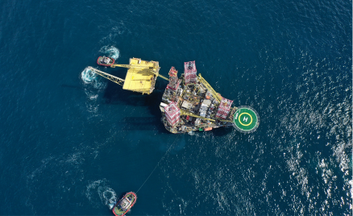
Disclaimers
Since forward-looking information addresses future events and conditions, by its very nature it involves inherent known and unknown risks and uncertainties which are beyond the control of Trillion. Actual results could differ materially from those currently anticipated due to a number of factors and risks. These factors and risks include, without limitation: the risk that the Offering will not be completed as anticipated or at all; volatility in market prices for oil and natural gas; the potential for the return of conditions that persisted during the recent global crisis and economic downturn; risks and liabilities inherent in oil and gas operations; uncertainties associated with estimating oil and natural gas reserves; geological, technical, drilling and processing problems; fluctuations in foreign exchange or interest rates and stock market volatility; changes in the laws or application thereof by the Government of Turkiye, including tax and environmental requirements; capital expenditure programs and the timing and method of financing thereof; the risk that the benefit derived from capital expenditure programs will not be as anticipated; unexpected decline rates in wells; wells not performing as expected; delays resulting from or inability to obtain required third party and regulatory approvals; ability the ability of Trillion to achieve drilling success consistent with management's expectations; inability to access gas transportation and processing infrastructure; operating costs; future production levels of the Trillion's assets; expected plans and costs of drilling; drilling inventory and presence of gas pools; projections of costs; supply and demand for oil and natural gas; expected levels of royalty rates, operating costs, general and administrative costs, cost of services and other costs and expenses; the effects of weather, catastrophes and public health crises, including the COIVD-19 pandemic; and such risks and uncertainties contained under the heading titled "Risk Factors" in the Prospectus. Readers are cautioned that the foregoing list of possible risks and uncertainties is not exhaustive. Although Trillion has attempted to identify important factors and risks that could cause actual actions, events or results to differ materially from those described in the forward-looking information, there may be other factors and risks that cause actions, events or results not to be as anticipated, estimated or intended.
Trillion's actual results, performance or achievement could differ materially from those expressed in, or implied by, the forward-looking information and, accordingly, no assurance can be given that any of the events anticipated by the forward-looking information will transpire or occur, or if any of them do so, what benefits that Trillion will derive therefrom. The forward-looking information contained in this Presentation is made as at the date of this Presentation and Trillion does not undertake any obligation to update publicly or to revise any of the included forward-looking information, whether as a result of new information, future events or otherwise, except as may be required by applicable securities laws.
Future-Oriented Financial Information
To the extent any forward-looking statement in this Presentation constitutes future-oriented financial information or financial outlook information (collectively, "FOFI") within the meaning of applicable securities laws, such information is used to provide information about management’s current expectations and plans relating to the future development of Trillion’s business. The reader is cautioned that this information may not be appropriate for any other purpose and the reader should not place undue reliance on such FOFI. FOFI, as with forward-looking information generally, is, without limitation, based on the assumptions and subject to the qualifications set out above under the heading "Forward-looking Information". The Company disclaims any intention or obligation to update or revise any FOFI contained in this Presentation, whether as a result of new information, future events or otherwise, unless required pursuant to applicable securities law. Readers are cautioned that the FOFI contained in this Presentation should not be used for purposes other than for which it is disclosed herein
Market and Industry Data
Certain market, independent third party and industry data contained in this Presentation is based upon information from government or other independent industry publications and reports or based on estimates derived from such publications and reports. Government and industry publications and reports generally indicate that they have obtained their information from sources believed to be reliable, but none of the Company or any of its agents has conducted its own independent verification of such information. While the Company believes this data to be reliable, market and industry data is subject to variations and cannot be verified with complete certainty due to limits on the availability and reliability of raw data, the voluntary nature of the data gathering process and other limitations and uncertainties inherent in any statistical survey. None of the Company or any of its agents has independently verified any of the data from independent third party sources referred to in this Presentation or ascertained the underlying assumptions relied upon by such source.
Currency
References to dollars or "$" are to U.S. dollars unless specified otherwise.
.

Slide 3
Company Highlights
European Gas Production- SASB Gas Field
49% Interest in SASB Gas Field, Black Sea, Turkiye - 323 BCF OGIP (100%) Our NPV10=$421m, 2P reserves 55.8 BCF (Dec 31 ‘23) up from 42 BCF (2022)
Development Program targeting ~ 17 + production wells
- 2023 - 5 wells drilled in 2023
- 2024 – 4+ workovers Cost $2.7m
Targeting production increase to 8.5mmcf/d exit rate end of ’24
Oil Exploration SE Turkey
Oil Exploration opportunities in S.E. Turkey proximate to recent discoveries
Recent Achievements
Raised $55 million equity +$15m subordinated debt financing
Successfully drilled 5 long reach Natural Gas production wells in the Black Sea using novel technology
Production increase +300% from 2022 to 2023
Seismic completed Oil Exploration opportunity SE Turkey
Successfully completed SASB perforation program in July 2024
Market Capitalization:
Oct 03 ‘24
Historical CAPEX SASB Gas Field (100% interest)
Low Royalty Rate
Reserves
Growth
Market Cap:
CND$ 16.38m
High Natural Gas Prices
Share Price
CND$ 0.105
Basic Shares Outstanding
:
157,082,516
USD$10/MCF
(Oct 2024)
$680m
12.5%
22.5%
Warrants
81,911,1427
Options
1,060,000
F.D. Shares Outstanding
240,053,658
  **See appendix for definitions. Management estimate for current 20+ well drilling program.
CSE: TCF | Frankfurt: Z620 | OTCQB: TRLEF
  *Operator of drilling operations and work/drilling program; TPAO is operator for daily production activities

Slide 4
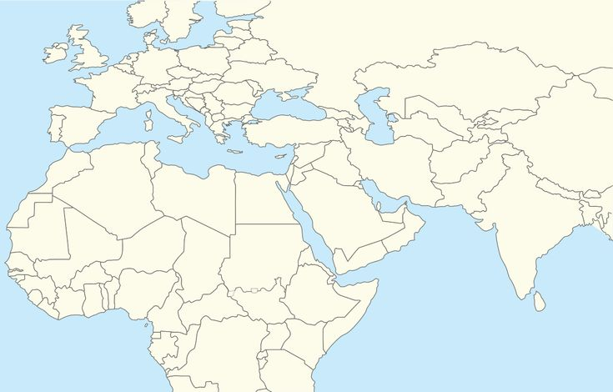
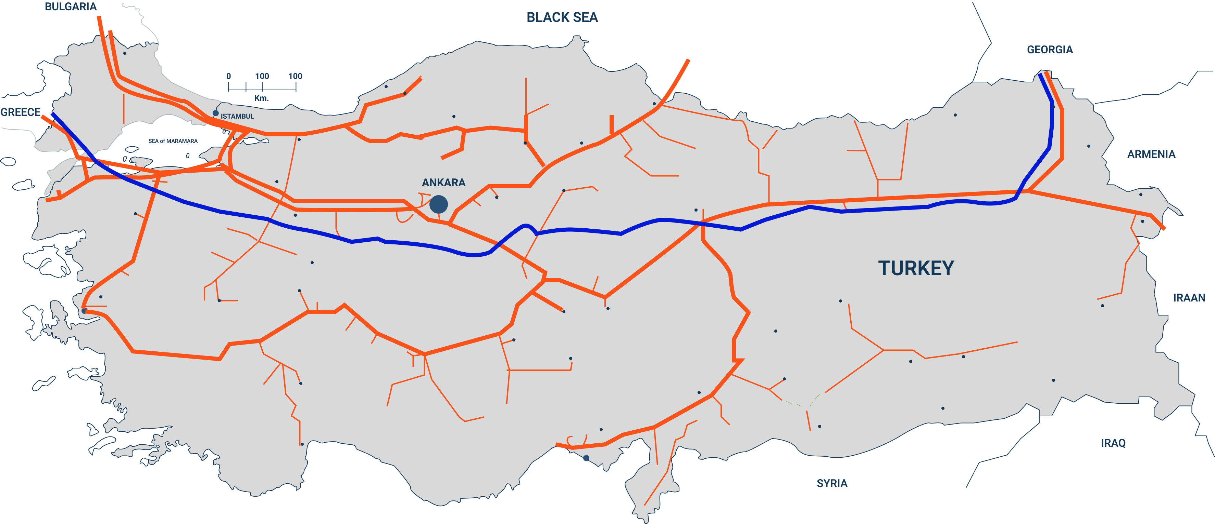

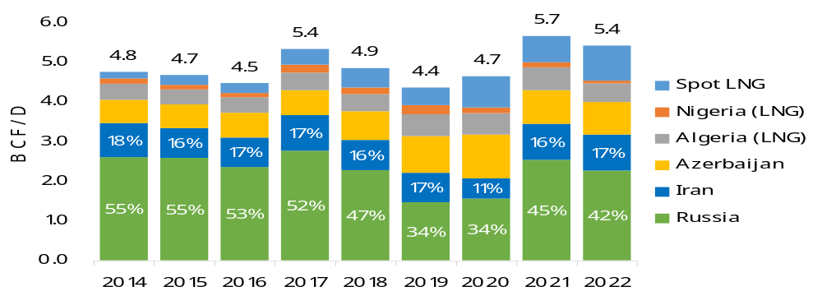
Turkiye Advantage
Strong Prices & Demand for Natural Gas & Oil
  98% Imported Nat Gas
  92% Imported Oil
The UK
EUROPE
USD$10/MCF
(Gas Price October 2024)
  ~60% of gas imports from Russia/Iran
TURKIYE
Excellent fiscal regime:
12.5% Royalty rate
22% Corporate Tax Rate
National Natural Gas Pipeline Grid in Turkiye
SASB tied into pipeline here
  7th Largest Nat Gas consumer in world - over 48 BCM/ year
TURKSTREAM
New Pipeline
Existing Pipeline
TANAP Pipeline
Turkiye Import Volumes of Natural gas
*Source: S&P Capital IQ

Slide 5
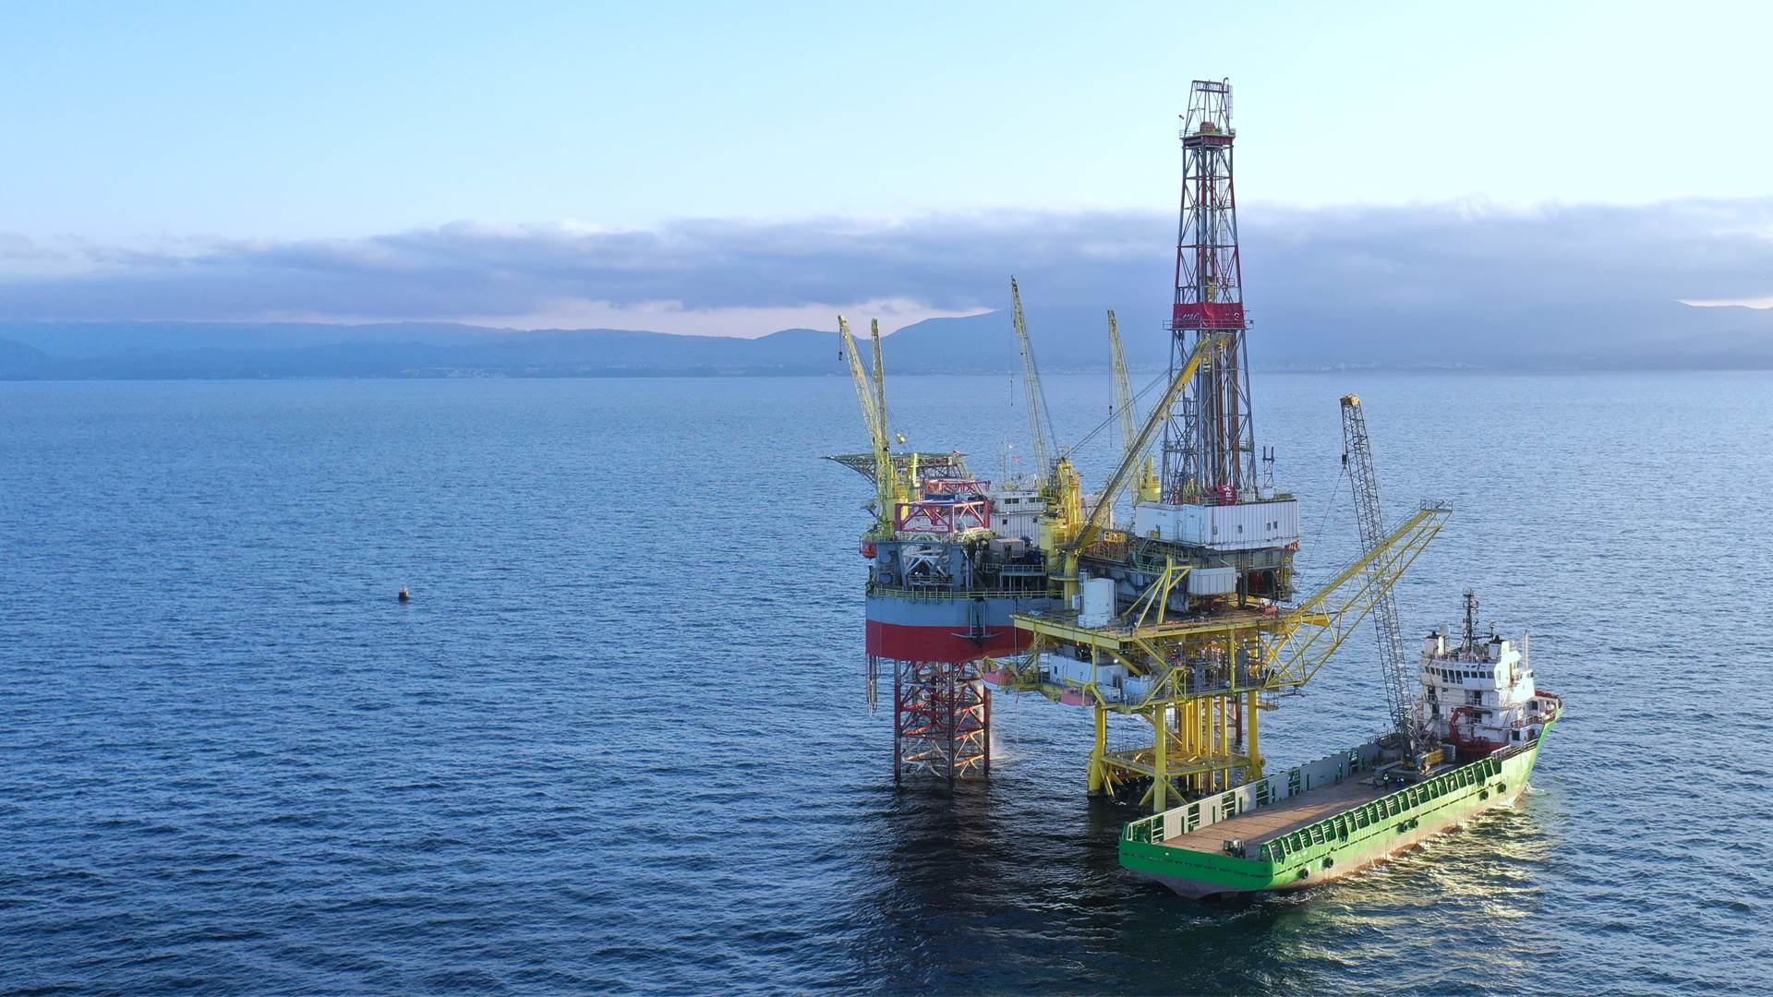
Black Sea – the new Natural Gas frontier fueling Europe

Slide 6
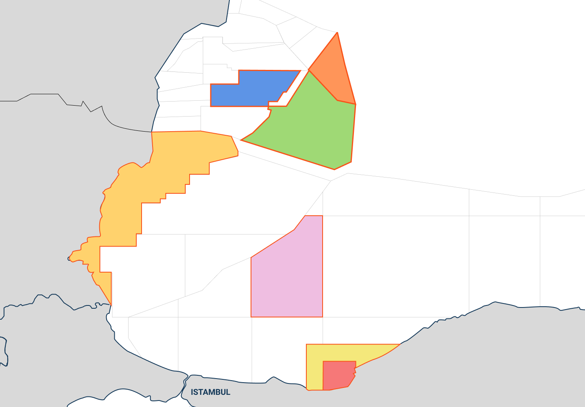
Black Sea Natural Gas Fields
Midia Gas Development
(Romania)
Owner: BSOG (70%),
Petro Ventures (20%),
Gas Plus (10%)
TRIDENT (EX-30) Gas FIELD
(Romania)
Owner: LukOil (87.8%), Romgaz (12.2%)
DOINA
Reserves: 56 BCF⁽¹⁾
ANA
Reserves:
226 BCF⁽¹⁾
The Black Sea is a key strategic area
to regional
energy future
ROMANIA
1
2
LIRA-1X
Reserves: Est. 1 TCF⁽²⁾
Galata Gas field
(BULGARIA)
Owner: Petroceltic (100%)
Reserves: 81 BCF⁽⁴⁾
3
4
DOMINO
Reserves: Est. 4 TCF⁽³⁾
5
NEPTUN DEEP GAS FIELD
(Romania)
Owner:
OMV Petrom (50%), Romgaz (50%)
PELICAN SOUTH
Reserves: Est. 700 – 900 BCF⁽³⁾
Sakarya GAS FIELD
(TURKEY)
Owner: TPAO (100%)
BULGARIA
SAKARYA
Reserves: Est. 10 - 23 TCF⁽⁶⁾
BLACK SEA
Source: www.blackseaog.com
Source: https://www.lukoil.com/PressCenter/Pressreleases/Pressrelease?rid=50864
Source: S&P Global: Commodity Insights - E&P activity in the Romanian and Bulgarian waters of the Black Sea, Oct. 2017.
Source: https://www.offshore-technology.com/projects/galata-field/
Source: Trillion Energy GLJ Report, Reserves and Prospective Resources (Risked)
Source: https://www.reuters.com/business/energy/turkeys-natural-gas-found-black-sea-now-comes-710-bcm-erdogan-2022-12-26/
6
SASB GAS FIELD
(TURKEY)
Owner: Trillion Energy (49%), TPAO (51%)
OGIP: 323.3 BCF⁽⁵⁾
TURKEY

Slide 7
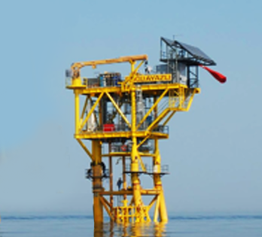
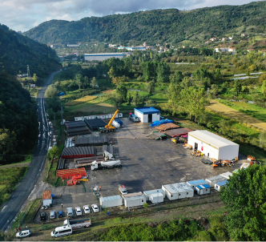
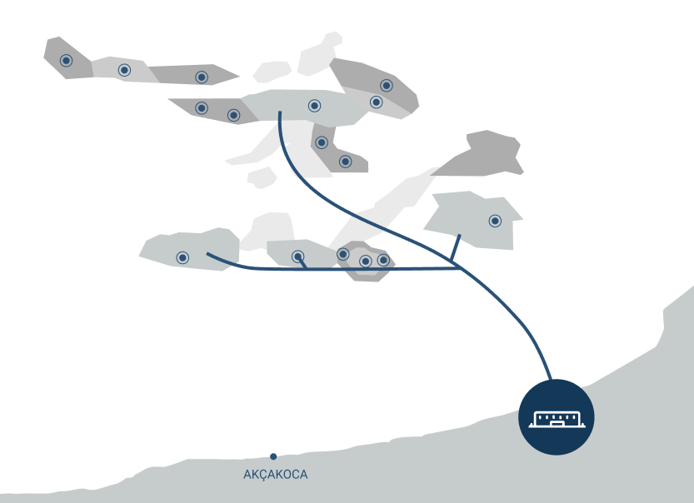

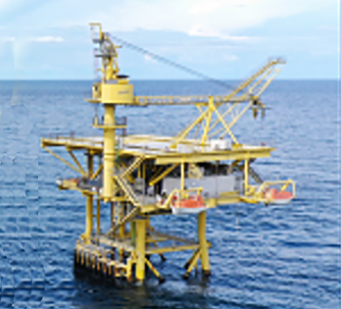
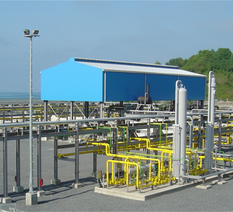
SASB Infrastructure – Solid platform for future growth
4 offshore production platform & tripods
Offshore platforms
@ SASB Gas Field, Black Sea
Shore Base
Drilling radius reachable from existing platforms ~ 3km
Onshore Gas Processing Facility
Onshore Gas Processing Facility
rated 75MMcf/day, expandable to 150MMcf/day
Processing facility tied into
national Natural Gas pipeline grid
US $600m+ invested into
historical wells & infrastructure
12,387 Hectare development lease valid until 2031 extendable to 2041
18km subsea pipeline + onshore pipeline

Slide 8
Solid Reserves Growth
Net Reserves Summary and Net Present Value*
Strong Reserves Growth
Conventional
NPV – 10%
Natural gas (Bcf)
Before Income Tax (US$M)
Dec 31 ‘23
Dec 31 ‘22
Dec 31 ‘23
Dec 31 ‘22
Proved
PPP 96.6
Producing
1.3
2.4
$11.5
$42.3
Developed Non-Producing
8.4
0.0
$81.9
$1.1
PPP 73.7
Undeveloped
8.3
7.7
$40.9
$80.3
Total Proved
18.0
10.1
$134.3
$123.8
PPP 31.4
PP
55.8
Total Probable
37.8
32.4
$286.2
$307.8
PP
42.5
Total Proved + Probable
55.8
42.5
$420.5
$431.5
Total Possible
40.8
31.2
$292.2
$299.1
PP 20.1
Total PPP
96.6
73.7
$712.7
$730.6
P 11.5
P 10.1
P 18.0
2021
2022
2023
*See Appendix for Glossary of Oil and gas terms. All figures presented in accordance with COGEH standards. Reserves and resources represent Trillion’s 49% interest at SASB conventional natural gas resources. *See Trillion’s Form 51-101F1 effective December 31, 2023 for third party reserve estimates. ** NPV 10 values assumes pricing as at December 31, 2023,. *** Future work programs include unrisked prospective resources and which are management estimates based on preliminary seismic data which is being reprocessed this year. Recovery factor used ranges between 57-70%.
P – total proved reserves
(producing, developed non-producing and undeveloped)
PP – total proved and probable reserves
PPP – total proved, probable and possible reserves

Slide 9

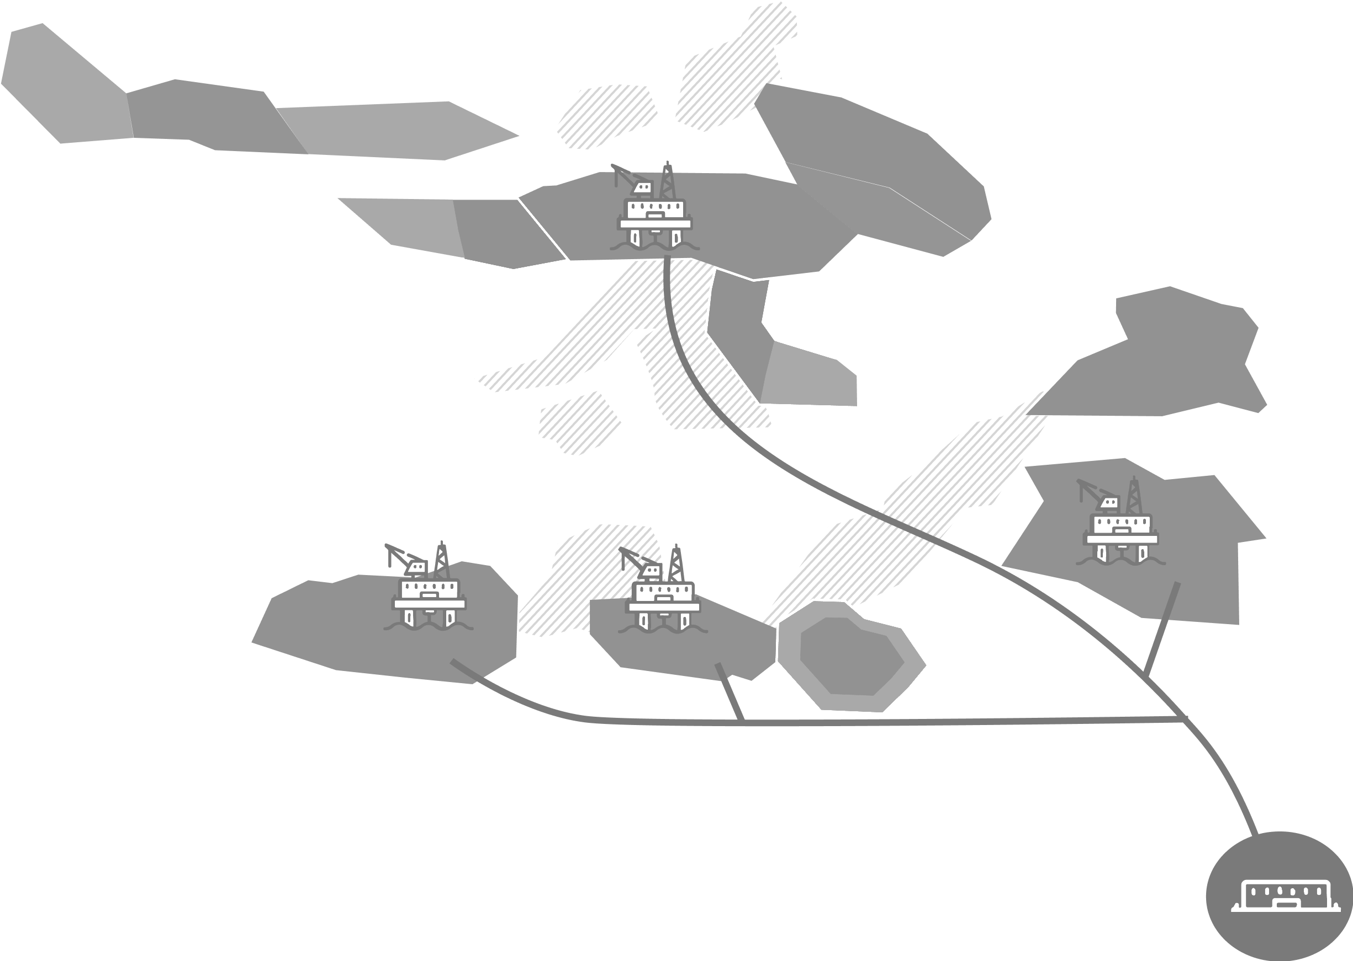



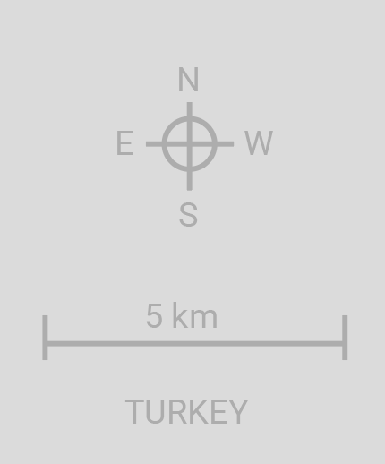
SASB Production Ramp Up 17+ Wells
BLACK SEA
West Akcakoca
Akcakoca-3
Tested 5.9 MMCF/D
Tested 7 MMCF/D
Guluc – 2 Well
Production Platform
2025+ Future Drilling Locations
2022-2023 Drilled locations
2024 Future Drilling Locations
[v
Tested 16.35 MMCF/D
Guluc Gas Field
Eskikale Gas Field
South Akcakoca Gas Field
Akcakoca Gas Field
Alapli Gas Field
SA-2 Well
Tested 7-8 MMCF/D
Alapli -2 Well
Completed July ‘23
Channel sands prospects
Akkaya Gas Field
Ayazli Gas Field
East Ayazli Gas Field
18 km of subsea pipeline installed
Bayhanli Gas Field
Bayhanli – 2 Well
Tested 11.9 MMCF/D
Cayagzi Onshore Gas Processing Facility

Slide 10
SASB Work Program 2024
Ramping up production through ALS, new perforations and sidetrack wells
Anticipated Production Exit Rates
14-16 MMcf/d
10-14 MMcf/d
Increase production on existing wells by installing artificial lift (water pumps) - Cost $2.7m
Add new sidetrack wells to SASB after Velocity String program is implemented
Cost: $4m each (49% interest)
100% MMcf/d Gross
5-7 MMcf/d**
7-8 MMcf/d**
**Company 49%
Q1-Q2 ‘24
Q3-Q4 ‘24
Program Timeline
Wells:
Q3 ‘24
Q4 ‘24
’25+
Guluc-2
6-7 Sidetrack Wells planned for 2025
Perf. & Velocity String
South Akcakoca-2
Perf. & Velocity String
West Akcakoca-1
Perf. & Velocity String
2022-2023
2024
Akcakoca-3
Perf. & Velocity String
Alapli-2
Velocity String
6 wells
drilled
4+
workovers
Bayhanli-2
Velocity String
East Ayazli-1
Velocity String & Gas Lift
East Ayazli-2
Velocity String & Gas Lift
for long-term production + compressor upgrades
Akcakoca-5
Velocity String & Gas Lift
Production started 2024
Side-Track program commencement
sidetracks

Slide 11
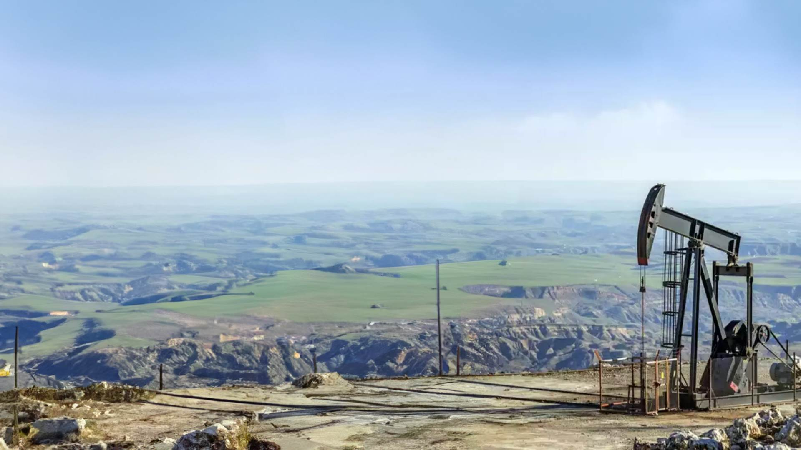
Top Onshore Oil Play in Mid-Europe
Cudi-Gabar Region Oil Block, South-East Turkiye

Slide 12
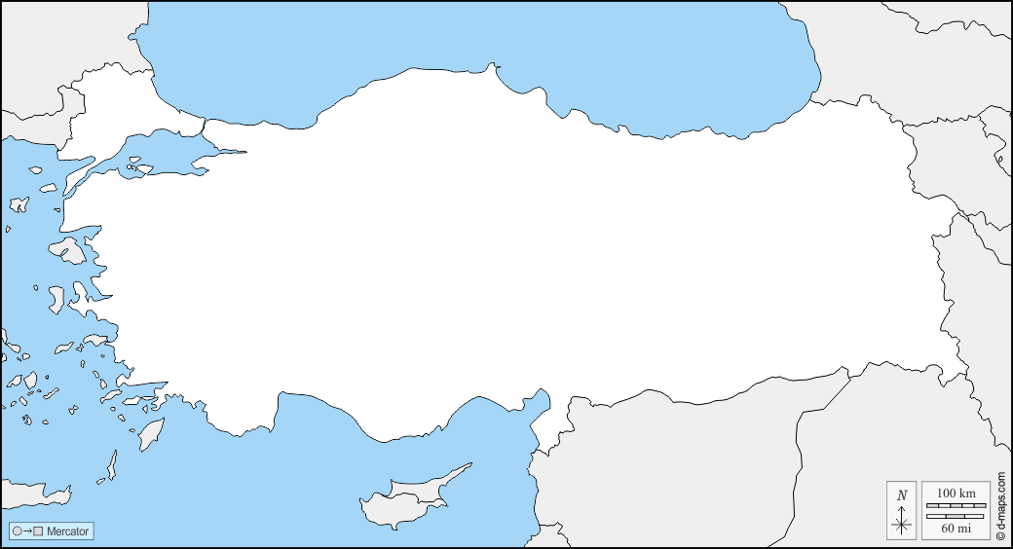
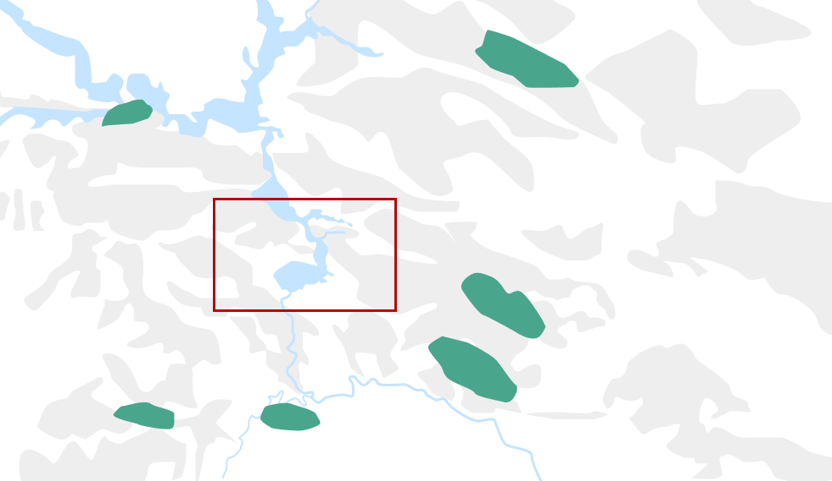

Oil Exploration Work Program
Cudi-Gabar Province, South-East Turkiye
TURKIYE
Exploration block M47c3,c4 is close to recent high impact discoveries and oil fields
10 wells program targeting discovery of 10,000 – 100,000 bbl/day oil field discovery. PPE to drill 4 wells and shoot seismic
2D seismic collection finished for the block
TURKIYE
East Sadak Oil Field
Kedil Oil Field
New Discovery
4 million Bbl OOIP
26 API
28 Million Bbl Recoverable¹
43 API¹
M47C3,C4
Sehit Aybuke Yalcin Oil Field
11 km
New Major Discovery
If a discovery is made, economics are pro-rata to respective interests
Wells expected to cost USD $3.5 million each (gross 100%)
1 Billion Bbl OOIP²
Ogunduk Oil Field
12 km
New Discovery
Sehit Esma Cevik Oil Field
22 API
New Discovery
Dirsekli Oil Field
250m Bbl OOIP² 150M Recoverable²
21 API
The definitions used are those contained in The Canadian Oil and Gas Evaluation Handbook maintained by the Society of Petroleum Evaluation Engineers (Calgary Chapter) ("COGEH") and National Instrument 51-101 - Standards of Disclosure for Oil and Gas Activities
LEGEND:
Oil Fields and Discoveries
Trillion’s Oil Exploration
[v
1. UKOG Why SE Turkey & Basur-Resan Presentation, 2021 - https://www.ukogplc.com/ul/UKOG_Turkey_Slides%20_FINAL_190121.pdf
2. https://www.tpao.gov.tr/file/2212/en-sehit-esma-cevik-bilgi-notu-114363997195a6d60.pdf and https://www.tpao.gov.tr/file/2305/kamuoyu-duyurusu-eng-13416452d270cb2e3.pdf

Slide 13
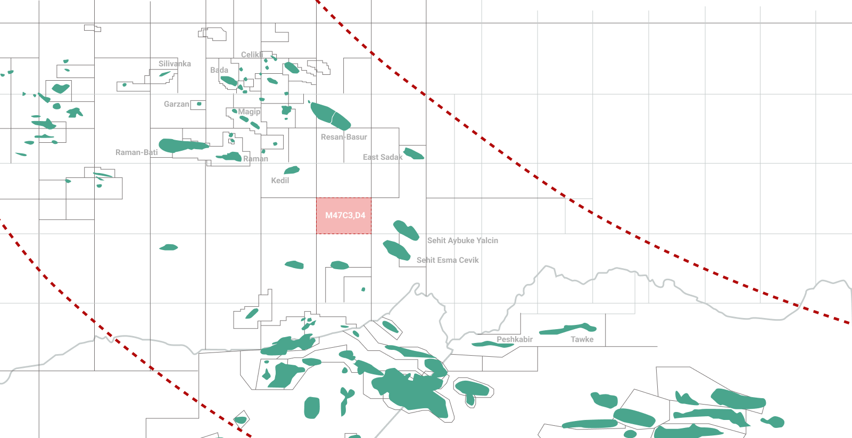
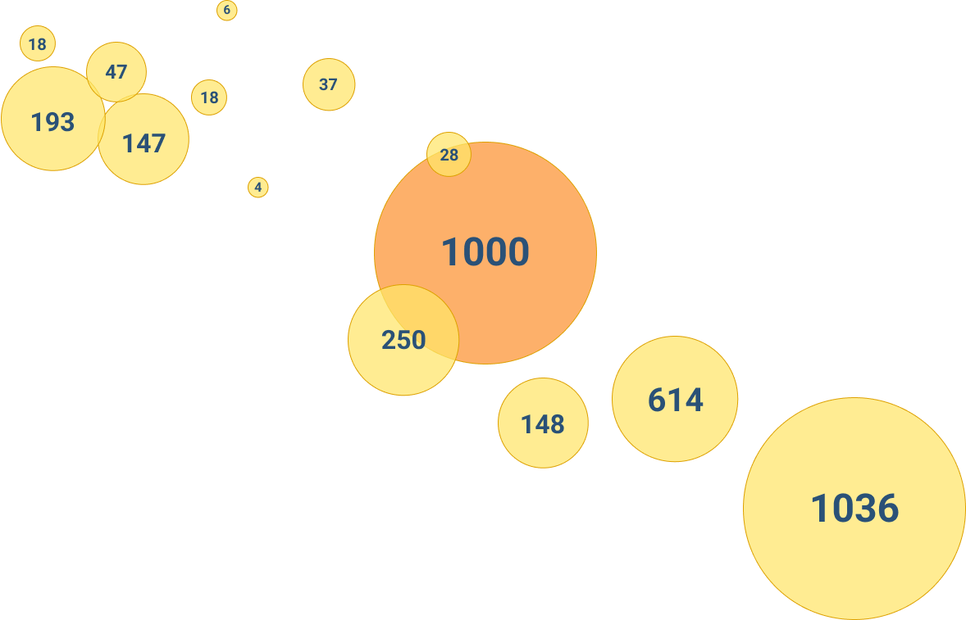
Regional Oil Fields
Oil Rich Region Extending from Iraq and Syria
LEGEND:
Licenses
Oil Fields and Discoveries
Trillion’s Oil Exploration
Recoverable Oil in Millions of barrels*
Oil In Place (OOIP) in Millions of barrels**
Oil Exploration Fairway
[v
TURKIYE
Trillion’s Farmin Eastern Block
SYRIA
IRAQ
*UKOG Why SE Turkey & Basur-Resan Presentation, 2021 - https://www.ukogplc.com/ul/UKOG_Turkey_Slides%20_FINAL_190121.pdf
** TPAO Press Release May 2023 https://www.tpao.gov.tr/file/2305/kamuoyu-duyurusu-eng-13416452d270cb2e3.pdf

Slide 14
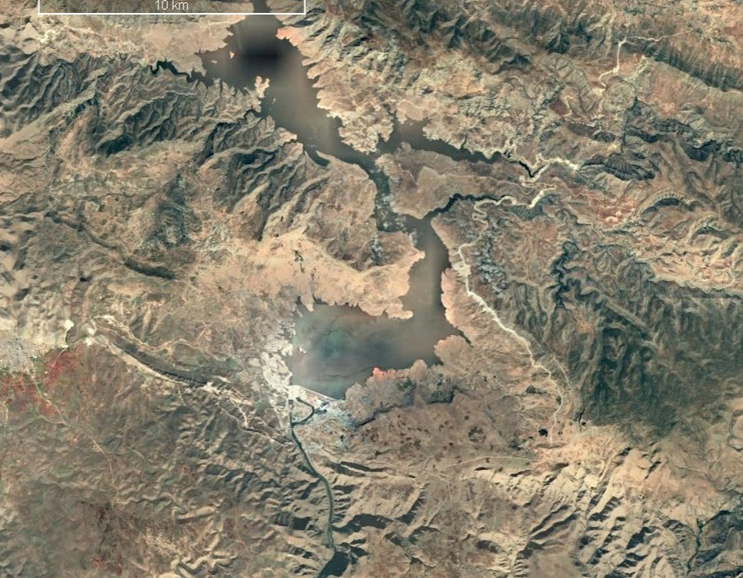

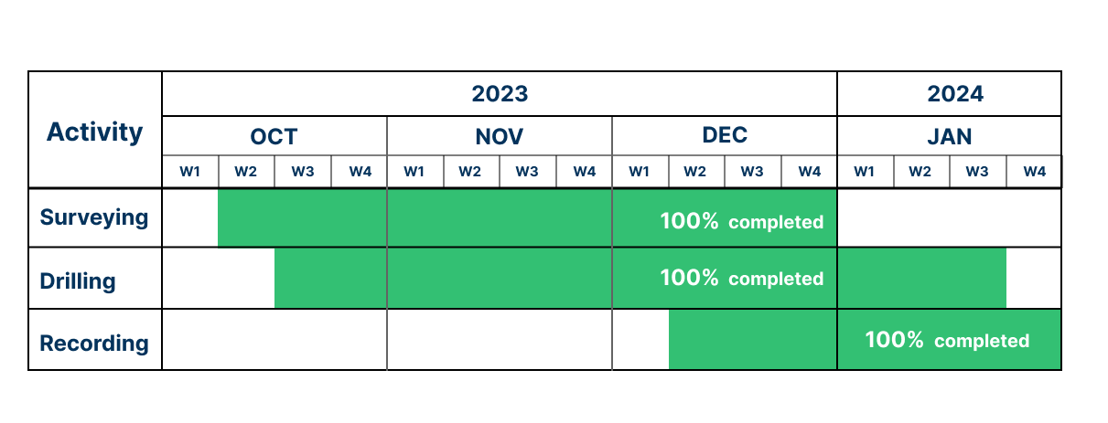

M47c3,c4 2D Seismic Acquisition Progress
Program Information
      50m shot point interval most of the area
      40m shot point interval over basaltic area
      10m receiver interval
      Line length: 150 km
      Nodal system
      Dynamite source
      9m hole depth
      6kg charge size
The objective of the seismic program in M47c3,c4 is to evaluate the potential oil trends as shown on the map. TPAO has discovered giant oil (43 API) fields, which are producing from Sayindere and Mardin Group Formations (2,000-2,500m total depths) such as Sehit Esma Cevik and Sehit Aybuke Yalcin (Gabar) fields.
M47C3,C4
Farm-in block boundaries
Surface anticline trend lines
TPAO proposed exploration wells
Seismic data collection area
Completed seismic data Mar 2024
Completed
Current status:
Data processing

Slide 15
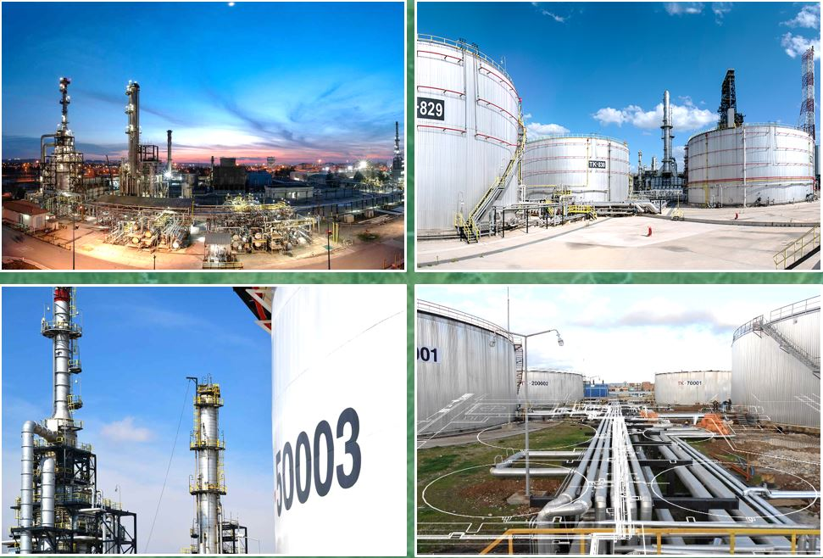
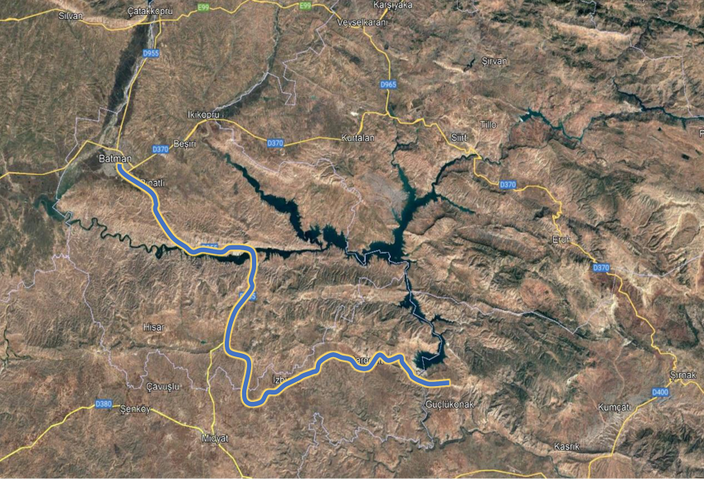


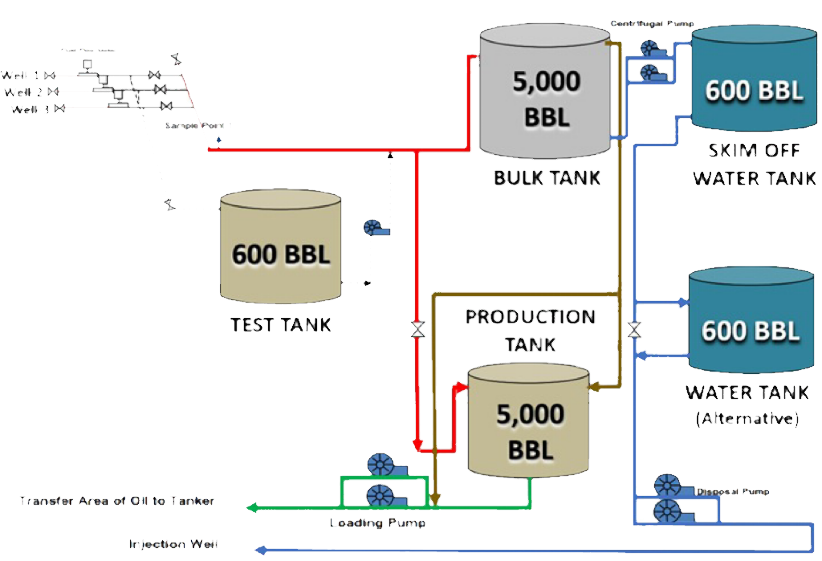


M47c3,c4 Production Potential for 2024*
*Subject to discovery being made
TURKIYE
Tüpraş Batman Oil Refinery
Early production through tank farm
250 bbls tanker trucks can take oil from discovery to the refinery 130 km away
Early production does not require water separation, but down the road it will need a simple water separator. Initial production is trucked for fast revenue
Estimated number of wells:
Est. per well production:
Est. daily field production:
Tank capacity:
Per truck capacity:
Number of trucks:
Distance to refinery:
10
1,000 bbl
10,000 bbl
11,800 bbl
250 bbl
20
130 km
Production Base
M47C3,C4
Sehit Aybuke Yalcin Field
Future Pipeline access potential
A pipeline will be constructed by TPAO, from Esma and Yalkin fields to the refinery which provides future access without trucking as pipeline develops
Sehit Esma Cevik Field
130 km distance
40 km

Slide 16
Corporate Summary
CSE: TCF | Frankfurt: Z620 | OTCQB: TRLEF
SASB Gas Field Highlights
Rapid Production Ramp-up Planned
Multi-well natural gas development program
US$410m NPV10 proved probable reserves
57 BCF proved probable reserves
Selling gas into worlds 6th largest market that is 90% dependent on imports
7 MMCF/d
5 MMCF/d
June ‘24
July ‘24
High Impact Oil & Exploration project
Oil field exploration in Cudi-Gabar Oil Petroleum Province S.E. Turkey
2D seismic data collection is completed and is being processed
Oil block
SASB
2 Exploration Wells planned for 2024
New Sidetrack Wells planned for 2025
2 exploration wells planned to be drilled in 2024 on M47c3,c4

Slide 17

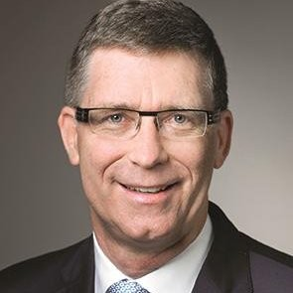
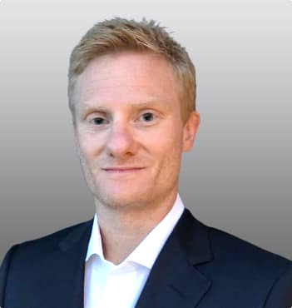
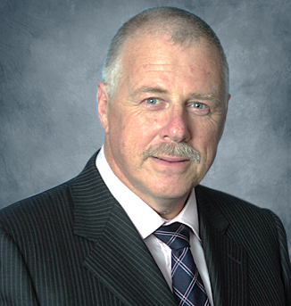
Directors & Management Team
Dr. Arthur Halleran
PRESIDENT, CEO & DIRECTOR
Jay Park, KC
DIRECTOR
Dr. Halleran has served as a director of Trillion Energy since October 4, 2011. He has a Ph.D. in Geology from the University of Calgary and 40 years of petroleum exploration and development experience. His international experience includes countries such as Canada, Colombia, Egypt, India, Guinea, Sierra Leone, Sudan, Suriname, Chile, Brazil, Bulgaria, Turkiye, Pakistan, Peru, Tunisia, Trinidad Tobago, Argentina, Ecuador and Guyana. Dr. Halleran has worked for Petro-Canada, Chevron, Rally Energy, Canacol Energy and United Hydrocarbon International Corp. In 2007, Dr. Halleran founded Canacol Energy Ltd., a company with petroleum and natural gas exploration and development activities in Colombia, Brazil and Guyana which made a billion-dollar natural gas discovery in Colombia.
Mr. Park is a renowned energy lawyer with a particular focus on upstream oil and gas transactions. He has worked on energy projects in more than fifty countries, including Turkey. He has advised international energy companies, including oil and gas explorers, producers, marketers, pipeline companies, state oil companies, governments, banks and multilateral agencies such as the World Bank. Mr. Park was formerly CEO and then Chairman of ReconAfrica exploring for oil & gas in Namibia and Botswana. During this period ReconAfrica was twice named to the TSX Venture 50 and was the top performing 2021 TSX Venture 50 company from the energy sector. Mr. Park is currently Executive Chairman of MCF Energy Ltd. exploring for gas in Europe.
Sean Stofer
DIRECTOR
David Thompson
DIRECTOR, AUDIT COMMITTEE CHAIR
Sean Stofer has over 20 years of renewable energy experience. Mr. Stofer is a graduate of the University of British Columbia in Engineering and is a registered Engineer in California. He is a founder of several successful renewable energy companies including for the arctic’s largest solar array; 250 MW of solar in the USA; 200+MW of wind projects and over 300MW of hydroelectric projects. He is COO of Green Data Center Real Estate, which uses renewable energy to power data centers. Sean is leading a project of over 500 MW using wind, solar and hydropower. Sean has worked closely with Government to guide policy and has consulted to a wide range of companies. Sean was awarded the Top 40 Under 40 in Vancouver, Canada for his business achievements.
Mr. Thompson has 30 years of financial experience in the oil and gas industry. He successfully founded an oil trading company in Bermuda, with offices in the U.S. and Europe, and was responsible for the company’s Turkmenistan production operations in the Lhamov and Zhdanoy oil fields (offshore Caspian Sea — part of the Turkmenistan project), which discovered producing reserves of 365M barrels oil and 2 TCF gas and successfully raised over $100M in equity. He is Managing Director of AMS Limited, a Bermuda based Management Company. He has served as Founder, President and CEO of Sea Dragon Energy Inc. (London exchange: SDX 21.00 GBP), Financial Director of Forum Energy Plc (AIM) and SVP at Larmag Group of Companies. Mr. Thompson is a Certified Management Accountant since 1998.

Slide 18
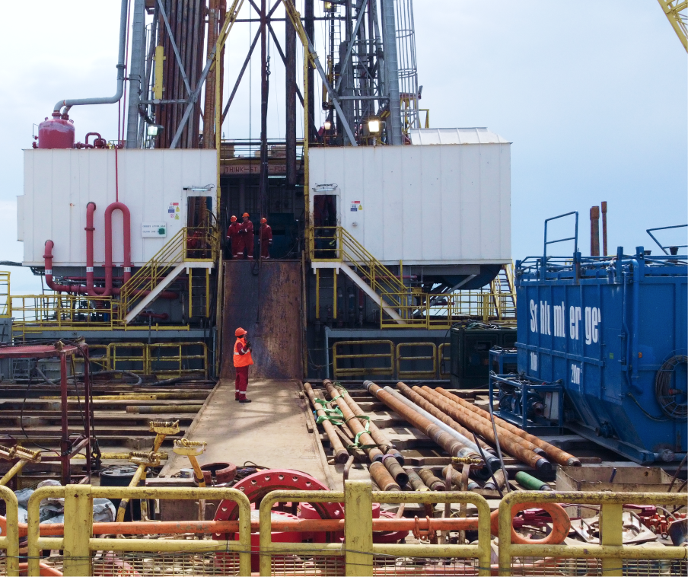
Contact
General Inquiries
info@trillionenergy.com
trillionenergy.com
Canada (Head Office)
Suite 700
838 West Hasting Street
Vancouver, BC V6C 0A6
Turkiye (Operations)
Oran Mah. Kudus Cad. 1/21 Park Oran Ofis Plaza, No:45, Kat:14, 06450,
Cankaya, Ankara, Turkiye

Slide 19
Presentation of Oil & Gas Information
Appendix
Presentation of Oil & Gas Information
BOEs have been converted on the basis of six thousand cubic feet (“Mcf”) natural gas to 1 barrel of oil. BOEs may be misleading, particularly if used in isolation. A BOE conversion ratio of 6 Mcf: 1 bbl is based on an energy equivalency conversion method primarily applicable at the burner tip and does not represent a value equivalency at the wellhead. In addition, given that the value ratio based on the current price of oil as compared with natural gas is significantly different from the energy equivalent of six to one, utilizing a BOE conversion ratio of 6 Mcf: 1 bbl would be misleading as an indication of value
Definitions
In this presentation:
“2P” are 1P reserves plus probable reserves.
“3P” are 1P plus 2P plus possible reserves.
“developed producing reserves” are those reserves that are expected to be recovered from completion intervals open at the time of the estimate. These reserves may be currently producing or, if shut-in, they must have previously been on production, and the date of resumption of production must be known with reasonable certainty.
“GAAP” means generally accepted accounting principles in the Unites States of America.
“NPV” means net present value.
“NPV10” means NPV discounted at 10%.
“possible reserves” are those additional reserves that are less certain to be recovered than probable reserves. There is a 10% probability that quantities actually recovered will equal or exceed sum of proved plus probable plus possible reserves. Possible reserves may be developed or undeveloped.
“probable reserves” are those unproved reserves that are less certain to be recovered than proved reserves. It is equally likely that actual remaining quantities recovered will be greater or less than sum of estimated proved plus probable reserves. Probable reserves may be developed or undeveloped.
“proved developed reserves” or “PDP” are those proved reserves that are expected to be recovered from existing wells and installed facilities or, if facilities have not been installed, that would involve a low expenditure (e.g., when compared to cost of drilling a well) to put reserves on production. Developed category may be subdivided into producing and non-producing.
“proved reserves” or “1P” are those reserves that can be estimated with a high degree of certainty to be recoverable. It is likely that actual remaining quantities recovered will exceed estimated proved reserves.
“reserves” are estimated remaining quantities of oil and natural gas and related substances anticipated to be recoverable from known accumulations, as of a given date, based on: (a) analysis of drilling, geological, geophysical and engineering data; (b) use of established technology; and (c) specified economic conditions, which are generally accepted as being reasonable. Reserves are classified according to degree of certainty associated with estimates.
“undeveloped reserves” are those reserves expected to be recovered from known accumulations where a significant expenditure (e.g., when compared to the cost of drilling a well) is required to render them capable of production. They must fully meet the requirements of the reserves category (proved, probable, possible) to which they are assigned.
Certain terms used in this presentation but not defined are defined in NI 51-101, CSA Staff Notice 51-324 -Revised Glossary to NI 51-101 Standards of Disclosure for Oil and Gas Activities (“CSA Staff Notice 51-324”) and/or the COGEH and, unless the context otherwise requires, shall have the same meanings herein as in NI 51-101, CSA Staff Notice 51-324 and the COGEH, as the case may be.
Reserves Information
Unless otherwise expressly stated, all reserves values, future net revenue, ancillary information and any measure of oil and gas activities contained in this presentation is as at January 31, 2023 and has been prepared and calculated in accordance with Canadian National Instrument 51-101 – Standards of Disclosure for Oil and Gas Activities (“NI 51-101”) and the Canadian Oil and Gas Evaluation Handbook (“COGEH”) and derived from a report with an effective date of January 31, 2023 prepared by GLJ Ltd. (“GLJ”), Trillion’s independent qualified reserves evaluator and auditor (the “GLJ Report”). Any reserves estimate or related information contained in this presentation as of a date other than January 31, 2023 has an effective date of January 31 of the applicable year and is derived from a report prepared by Trillion’s independent qualified reserves evaluator and auditor as of such date, and additional information regarding such estimate or information can be found in Trillion’s applicable Statement of Reserves Data and Other Oil and Gas Information on Form 51-101F1 filed on SEDAR at www.sedar.com.
Estimates of reserves provided in this presentation are estimates only and there is no guarantee that estimated reserves will be recovered. Actual reserves may be greater than or less than estimates provided in this presentation and differences may be material.
Oil & Gas Non-GAAP Terms.
Operating netback: Oil and gas sales less operating and transportation expenses. Operating netback per boe as presented is defined as oil and gas sales price less forecasts of transportation and quality discount, royalties, operating costs and pipeline transportation from the Brent oil price forecast.
Funds flow from operations: is defined as net income or loss adjusted for DD&A expenses, asset impairment, goodwill impairment, deferred tax expense or recovery, stock-based compensation expense, amortization of debt issuance costs, non-cash lease expense, lease payments, unrealized foreign exchange gains or losses, financial instruments gains or losses, other non-cash losses, cash settlement of financial instruments and other gains or losses.
EBITDA and Adjusted EBITDA: Net income adjusted for DD&A expenses, interest expense and income tax expense or recovery (“EBITDA”) and adjusted EBITDA, as presented, is defined as EBITDA adjusted for non-cash lease expense, lease payments, unrealized foreign exchange gain or loss, stock-based compensation expense or recovery, unrealized derivative instruments gain or loss, gain on re-purchase of Senior Notes, other financial instruments gain or loss and other loss.
Free cash flow (FCF): GAAP "net cash provided by operating activities" less projected capital spending. Management believes that free cash flow is a useful supplemental measure for management and investors to in order to evaluate the financial sustainability of the Company's business.
Net Debt: Comprised of cash and senior notes (gross).
Finding and development costs (F&D Costs): F&D costs are calculated as estimated exploration and development capital expenditures, excluding acquisitions and dispositions, divided by the applicable reserves additions both before and after changes in FDC costs. The calculation of F&D costs incorporates the change in FDC required to bring reserves into production.
These non-GAAP measures do not have a standardized meaning under GAAP. Investors are cautioned that these
measures should not be construed as an alternative to net income or loss or other measures of financial performance
as determined in accordance with GAAP. Gran Tierra's method of calculating these measures may differ from other
companies and, accordingly, it may not be comparable to similar measures used by other companies. These non-GAAP financial measures are presented along with the corresponding GAAP measure so as to not imply that more
emphasis should be placed on the non-GAAP measure.

